Slide 1

Python Programming
(Business & Analytics)
by Su Lee Seng,
Jan, 2021

Slide 2

Python Programming
(Business & Analytics)
by Su Lee Seng,
Jan, 2021

Slide 3

AI :
An Introduction
Python :
Introduction to Object Orientation (Part 1)
(( Please, scan QR code for attendance. ))

Slide 4
Object Orientation
Classes, Instances, Attributes and Methods

Slide 5
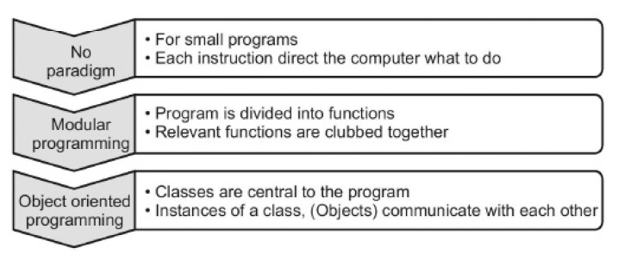
Python Programming - Introduction to Object Orientation :
Programming Paradigms
xx

Slide 6
New slide.
Python Programming - Introduction to Object Orientation :
OOP
Object-oriented programming (OOP) involves the use of objects to create programs. An object represents an entity in the real world that can be distinctly identified. For example, a student, a desk, a circle, a button, and even a loan can all be viewed as objects.
An object has a unique identity, state, and behavior.
■ An object’s identity is like a person’s Social Security number. Python automatically assigns each object a unique id for identifying the object at runtime.

Slide 7
New slide.
Python Programming - Introduction to Object Orientation :
OOP - state
An object’s state (also known as its properties or attributes) is represented by variables, called data fields.
A circle object, for example, has a data field radius, which is a property that characterizes a circle. A rectangle object has the data fields width and height, which are properties that characterize a rectangle.

Slide 8
New slide.
Python Programming - Introduction to Object Orientation :
OOP - methods
■Python uses methods to define an object’s behavior (also known as its actions).
Methods are defined as functions. You make an object perform an action by invoking a method on that object.
For example, you can define methods named getArea() and getPerimeter() for circle objects. A circle object can then invoke the getArea() method to return its area and the getPerimeter() method to return its perimeter.

Slide 9
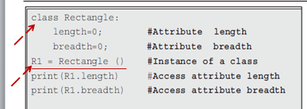
New slide.
Python Programming - Introduction to Object Orientation :
What is a Class ?
A class is simply a template for creating objects. Classes define an object's various properties and specify the things you can do with that object.
A Python class uses variables to store data fields and defines methods to perform actions.
A class is a contract—also sometimes called a template or blueprint—that defines what an object’s data fields and methods will be.

Slide 10
Python Programming - Introduction to Object Orientation :
What is a Class ?
Classes allow programmers to specify the structure of an object (i.e. its attributes or fields, etc.) and its behaviour separately from the objects themselves.
This is important, as it would be extremely time-consuming (as well as inefficient) for programmers to define each object individually. Instead, they define classes and create instances or objects of those classes.
They can then store related data together in a named concept which makes it much easier to structure and maintain code.

Slide 11
Python Programming - Introduction to Object Orientation :
What is a Class ?
Object Oriented Programming (or OOP) provides an approach to structuring programs/applications so that the data held, and the operations performed on that data, are bundled together into classes and accessed via objects.
As an example, in an OOP style program, employees might be represented by a class Employee where each employee has an id, a name, a department and a desk_number etc. They might also have operations associated with them such as take_a_holiday() or get_paid().

Slide 12
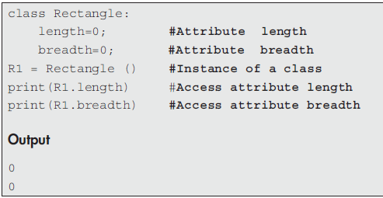
Python Programming - Introduction to Object Orientation :
Creating Classes
There are a few things to notice here. First, the keyword class indicates the definition of a class. This is followed by the name of the class — Rectangle.

Slide 13
Python Programming - Introduction to Object Orientation :
What Are Classes for?
For example, when defining the class Person we might give it:
  • a field or attribute for the person’s name,
  • a field or attribute for their age,
  • a field or attribute for their email,
  • some behaviour to give them a birthday (which will increment their age),
  • some behaviour to allow us to send them a message via their email,
  • etc.

Slide 14
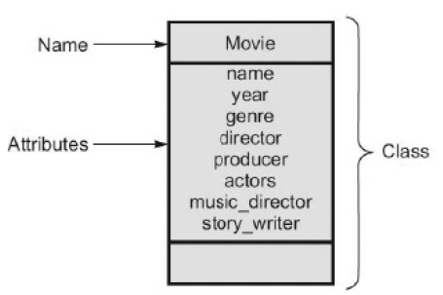
Python Programming - Introduction to Object Orientation :
Attributes (or fields)
The attributes here depict the characteristics of the entity that we are concerned with.

Slide 15
New slide.
Python Programming - Introduction to Object Orientation :
Class and objects (and Instantiation)
Objects of the same kind are defined by using a common class. The relationship between classes and objects is analogous to that between an apple-pie recipe and apple pies. You can make as many apple pies (objects) as you want from a single recipe (class).
An object is an instance of a class, and you can create many instances of a class. Creating an instance of a class is referred to as instantiation.
The terms object and instance are often used interchangeably. An object is an instance and an instance is an object.

Slide 16
New slide.
Python Programming - Introduction to Object Orientation :
Class and objects
xxx

Slide 17
Python Programming - Introduction to Object Orientation :
Instance of a Class – Instantiation
For example, to represent the people in a family we might create an example of the class Person with the name Paul, the age 52 and the address set to London. We may also create another Person object (instance) with the name Fiona, the age 48 and the address also of London and so on.
An instance or object is therefore an example of a class. All instances/objects of a class possess the same data variables but contain their own data values. Each instance of a class responds to the same set of requests and has the same behaviour.

Slide 18
Python Programming - Introduction to Object Orientation :
What Are Classes for?
In Python, classes are used:
  • as a template to create instances (or objects) of that class,
  • define instance methods or common behaviour for a class of objects,
  • define attributes or fields to hold data within the objects,
  • be sent messages.
Objects (or instances), on the other hand, can:
  • be created from a class,
  • hold their own values for instance variables,
  • be sent messages,
  • execute instance methods,
  • may have many copies in the system (all with their own data).

Slide 19
Python Programming - Introduction to Object Orientation :
Assessing Attributes of a Class
There are a few things to notice here. First, the keyword class indicates the definition of a class. This is followed by the name of the class — Rectangle.

Slide 20
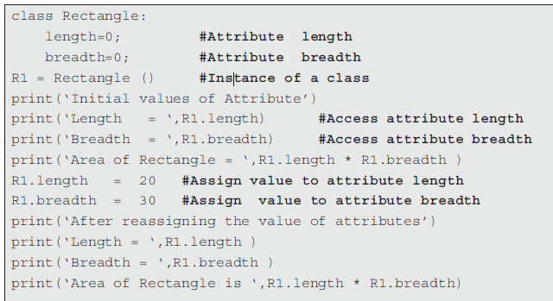
Python Programming - Introduction to Object Orientation :
Assigning Values to Attributes
xx

Slide 21
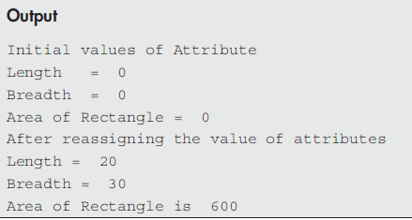
Python Programming - Introduction to Object Orientation :
Assigning Values to Attributes
xx

Slide 22
Object Orientation
Creating Classes

Slide 23
Python Style Guide & Naming Convention :
Python Naming Convention
Class names
Follow CapWord (or camelCase or StudlyCaps) naming convention. Just start each word with a capital letter and do not include underscores between words.
Class names are normally camel cased. Unlike functions where words are joined together with underscores, in camel casing, you capitalize the first letter of each word and then shove them together. Normally class names are nouns. In Python they cannot start with numbers
Example:
    # Follow CapWord convention
    class MySampleClass:
    pass

Slide 24
Introduction to Object Orientation - Creating Classes :
Creating Classes
The last character on the line is the colon (:). Remember that a colon indicates that you are going to define a block. In this case the block will be the code describing the state and methods on the class.
Note that everything below that first colon is indented.

Slide 25
Introduction to Object Orientation - Creating Classes :
Creating Classes
The following are examples of class names both good and bad:
  • Kitten # good
  • jaguar # bad - starts with lowercase
  • SnowLeopard # good - camel case
  • White_Tiger # bad - has underscores
  • 9Lives # bad - starts with a number
See PEP 8 for further insight into class naming.

Slide 26
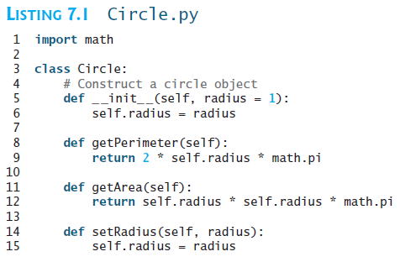
New slide.
Introduction to Object Orientation - Creating Classes :
An Example
xx

Slide 27
New slide.
Introduction to Object Orientation - Creating Classes :
An Example
Listing 7.1 defines the Circle class. The class name is preceded by the keyword class and followed by a colon (:).
The initializer is always named __init__ (line 5), which is a special method. Note that init needs to be preceded and followed by two underscores.
A data field radius is created in the initializer (line 6). The methods getPerimeter and getArea are defined to return the perimeter and area of a circle (lines 8–12).

Slide 28
Introduction to Object Orientation - Creating Classes :
Class Definitions
In Python, a class definition has the following format
    class nameOfClass(SuperClass):
    __init__
    attributes
    methods
Although you should note that you can mix the order of the definition of attributes, and methods as required within a single class. The following code is an example of a class definition
    class Person:
    def __init__(self, name, age):
    self.name = name
    self.age = age:

Slide 29
Introduction to Object Orientation - Creating Classes :
Creating Classes
The class statement creates a new class definition. The name of the class immediately follows the keyword class followed by a colon as follows −
    class ClassName:
    'Optional class documentation string'
    class_suite
The class has a documentation string, which can be accessed via ClassName.__doc__.
The class_suite consists of all the component statements defining class members, data attributes and functions.

Slide 30
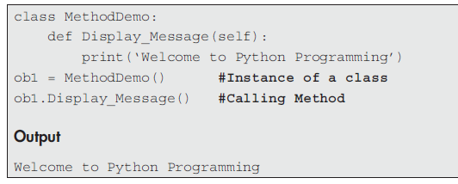
Introduction to Object Orientation - Creating Classes :
Adding Methods to a Class
In the program, the Display_Message() method takes no parameters but still the method has the self-parameter in the function definition. Therefore, the self-parameter refers to the current object itself. Finally, the method is called and the message is displayed.

Slide 31
Object Orientation self-parameter

Slide 32
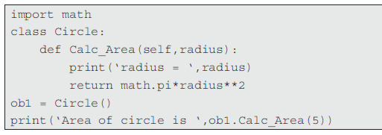
New slide.
Introduction to Object Orientation - The self-parameter :
The self-parameter
To add methods to an existing class, the first parameter for each method should be self. There is only one difference between class methods and ordinary functions.
The self-parameter is used in the implementation of the method, but it is not used when the method is called. Therefore, the self-parameter references the object itself.
Notes:
Even though the method Calc_Area() contains two parameters, viz. self and radius, only one parameter should be passed, viz. the radius of the circle while calling the method.

Slide 33
New slide.
Introduction to Object Orientation - The self-parameter :
The self-parameter
To add methods to an existing class, the first parameter for each method should be self.
There is only one difference between class methods and ordinary functions. The self-parameter is used
Notes:
xx

Slide 34
Introduction to Object Orientation - The self-parameter :
the self-parameter
To add methods to an existing class, the first parameter for each method should be self. There is only one difference between class methods and ordinary functions. The self-parameter is used in the implementation of the method, but it is not used when the method is called.
Python self variable is used to bind the instance of the class to the instance method. We have to explicitly declare it as the first method argument to access the instance variables and methods. This variable is used only with the instance methods.

Slide 35
New slide.
Introduction to Object Orientation - The self-parameter :
Accessing Members of Objects
An object’s member refers to its data fields and methods. Data fields are also called instance variables, because each object (instance) has a specific value for a data field.
Methods are also called instance methods, because a method is invoked by an object (instance) to perform actions on the object such as changing the values in data fields for the object.
In order to access an object’s data fields and invoke an object’s methods, you need to assign the object to a variable by using the following syntax:
objectRefVar = ClassName(arguments)
For example,
    c1 = Circle(5)
    c2 = Circle()
Notes:
x

Slide 36
New slide.
Introduction to Object Orientation - The self-parameter :
Accessing Members of Objects
You can access the object’s data fields and invoke its methods by using the dot operator (.), also known as the object member access operator. The syntax for using the dot operator is:
objectRefVar.datafield
objectRefVar.method(args)
Notes:
x

Slide 37
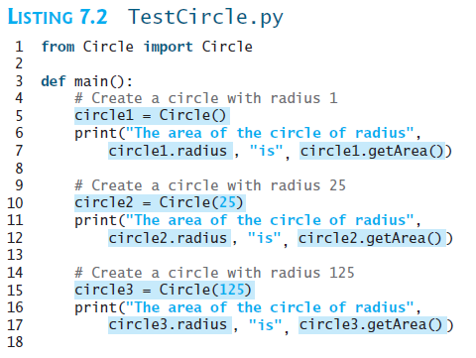
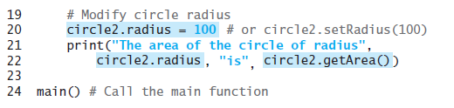
Example : Using Classes
New slide.
Example : Using Classes
Notes:
x

Slide 38
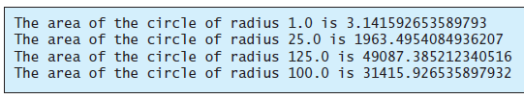
Example : Using Classes
New slide.
Example : Using Classes
Notes:
x

Slide 39
Introduction to Object Orientation - The self-parameter :
the self-parameter - Example
class MethodDemo:
def Display_Message(self):
print(‘Welcome to Python Programming’)
ob1 = MethodDemo() #Instance of a class
ob1.Display_Message() #Calling Method
Output :
Welcome to Python Programming
Notes:
In the above program, the Display_Message() method takes no parameters but still the method has the self-parameter in the function definition. Therefore, the self-parameter refers to the current object itself. Finally, the method is called and the message is displayed.

Slide 40
Introduction to Object Orientation - The self-parameter :
the self-parameter - Example
import math
class Circle:
def Calc_Area(self,radius):
print(‘radius = ‘,radius)
return math.pi*radius**2
ob1 = Circle()
print(‘Area of circle is ‘,ob1.Calc_Area(5))
Output :
radius = 5
Area of circle is 78.53981633974483
Notes:
The extra parameter radius is passed to a method defined inside the class Calc_Area(). The instance ob1 of a class is created and used to call the method of the existing class. Even though the method Calc_Area() contains two parameters, viz. self and radius, only one parameter should be passed, viz. the radius of the circle while calling the method.

Slide 41
Introduction to Object Orientation - The self-parameter :
the self-parameter
class Rectangle:
def Calc_Area_Rect(self,length,breadth):
print(‘length = ‘,length)
print(‘breadth = ‘,breadth)
return length*breadth
ob1 = Rectangle()
print(‘Area of Rectangle is ‘,ob1.Calc_Area_Rect(5,4))
Output :
length = 5
breadth = 4
Area of rectangle is 20

Slide 42
Introduction to Object Orientation - The self-parameter :
the self-parameter with instance variable
Program 10.8 Write a program for variable hiding.
class Prac:
x=5 # attribute x
def disp(self, x):
x=30
print(‘ The value of local variable x is ‘,x)
print(‘ The value of instance variable x is ‘,x)
ob=Prac()
ob.disp(50)
Output :
The value of local variable x is 30
The value of instance variable x is 30
Notes:
The instance variable x is initialised with the value 5. Similarly, the method disp() has a local variable named x and it is initialised with the value 30. Object ob is instantiated and the method disp() is invoked. Thereafter, it displays both the values of x as 30.

Slide 43
Introduction to Object Orientation - The self-parameter :
the self-parameter
class Self_Demo:
def Method_A(self):
print(‘In Method A’)
print(‘wow got called from A!!!’)
def Method_B(self):
print(‘In Method B calling Method A’)
self.Method_A() #Calling Method_A
Q=Self_Demo()
Q.Method_B() #calling Method_B
Output :
In Method B calling Method A
In Method A
wow got called from A!!!

Slide 44
Introduction to Object Orientation :
Accessing Attributes of a Class
class Rectangle:
length=0; #Attribute length
breadth=0; #Attribute breadth
R1 = Rectangle () #Instance of a class
print(R1.length) #Access attribute length
print(R1.breadth) #Access attribute breadth
Output :
0
0
Notes:
Explanation:
The class Rectangle is created as shown above. The class contains two attributes, viz. length and breadth. Initially the values of both the attributes are assigned to zero. R1 is the instance of the class. The object R1 and dot operators are used together to print the value of the attributes of a class.

Slide 45
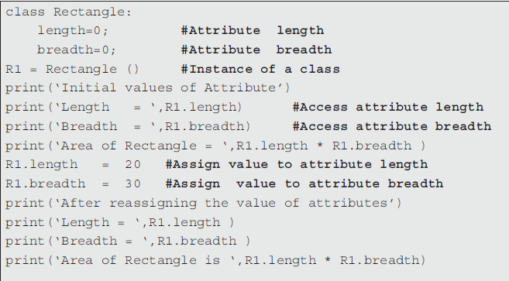
Introduction to Object Orientation :
Assigning Value to an Attribute
xxx
Notes:
xx

Slide 46
Python Programming - Introduction to Object Orientation :
Accessing Attributes of a Class
Output :
Initial values of Attribute
Length = 0
Breadth = 0
Area of Rectangle = 0
After reassigning the value of attributes
Length = 20
Breadth = 30
Area of Rectangle is 600
xxx
Notes:
xx

Slide 47
Object Orientation
The __init__ method (constructor)

Slide 48
Introduction to Object Orientation :
Methods
Inside of the body of a class are methods
Methods are simply functions that are attached to a class. Instead of calling the method by itself, you need to call it on an instance of the class.
The first method defined is the __init__ (dunder init) method. This is a special constructor method that is called when you create an instance of the class. Inside a constructor you bind data to the instance.
Normally, most class methods have self as their first parameter. self is a reference to the instance of the class.

Slide 49
New slide.
Introduction to Object Orientation :
An Example
xx

Slide 50
The Constructor ( __init__( ) ) :
the __init__ method (constructor)
The __init__ method is known as an initialiser/ constructor. It is a special method that is used to initialise the instance variable of an object. This method runs as soon as an object of a class is instantiated. The syntax of adding __init__ method to a class is given as follows:
class Class_Name:
def __init__(self): #__init__ method
…………………………
…………………………
This method is invoked to initialize a new object’s state when it is created. An initializer can perform any action, but initializers are designed to perform initializing actions, such as creating an object’s data fields with initial values.

Slide 51
The Constructor ( __init__( ) ) :
An Example
xx

Slide 52
The Constructor ( __init__( ) ) :
the __init__ method (constructor)
Note that init needs to be preceded and followed by two underscores.
Also __init__ method must have self as the first argument.
As self refers to the object itself, it refers to the object that invokes the method. The self-parameter within the __init__ method automatically sets the reference for the object just created.
The __init__ method can also have positional and/or keyword arguments.

Slide 53
New slide.
The Constructor ( __init__( ) ) :
Constructing Objects : __init__ Methods
Once a class is defined, you can create objects from the class with a constructor. The constructor does two things:
■ It creates an object in the memory for the class.
■ It invokes the class’s __init__ method to initialize the object.
All methods, including the initializer, have the first parameter self. This parameter refers to the object that invokes the method. The self parameter in the __init__ method is automatically set to reference the object that was just created. You can specify any name for this parameter, but by convention self is usually used.

Slide 54
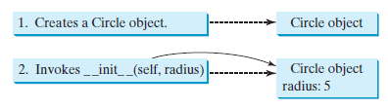
New slide.
The Constructor ( __init__( ) ) :
Constructing Objects : __init__ Methods
The arguments of the constructor match the parameters in the __init__ method without self.
For example, since the __init__ method in line 5 of Listing 7.1 is defined as __init__(self, radius = 1), to construct a Circle object with radius 5, you should use Circle(5).
Figure below shows the effect of constructing a Circle object using Circle(5). First, a Circle object is created in the memory, and then the initializer is invoked to set radius to 5.
Notes:
- A circle object is constructed using Circle(5).
- The initializer in the Circle class has a default radius value of 1. The following constructor creates a Circle object with default radius 1: Circle()

Slide 55
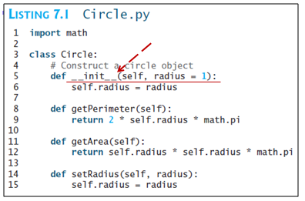
New slide.
The Constructor ( __init__( ) ) :
Constructing Objects
The initializer in the Circle class has a default radius value of 1. The following constructor creates a Circle object with default radius 1:
Circle()
Notes:
x

Slide 56
The Constructor ( __init__( ) ) :
the __init__ method (constructor) - Example 1
class Circle:
def __init__(self,pi):
self.pi = pi
def calc_area(self,radius):
return self.pi*radius**2
C1=Circle(3.14)
print(‘ The area of Circle is ‘,C1.calc_area(5))
Output :
The area of Circle is 78.5
Notes:
In the above program we have created a class named Circle. The class contains two
different methods, viz. one is __init__ method and another calc_area() to calculate the area of a
circle. Notice that in the above program we do not explicitly call the __init__ method. We have
created an instance of the class Circle, i.e. C1. While creating the instance of the class we have
passed the arguments following the class name to initialise the instance variable of an object.

Slide 57
The Constructor ( __init__( ) ) :
the __init__ method (constructor) - Example 2
class Circle:
pi = 0; #Attribute pi
radius = 0 #Attribute radius
def __init__(self):
self.pi = 3.14
self.radius = 5
def calc_area(self):
print(‘Radius = ‘,self.radius)
return self.pi*self.radius**2
C1=Circle()
print(‘ The area of Circle is ‘,C1.calc_area())
Output :
The area of Circle is 78.5
Notes:
Initially the attributes of the class Circle, i.e. pi and radius are initialised to Zero.
With the help of the init method the value of the instance variable pi and radius are reinitialised to
3.14 and 5. These values are initialised upon the creation of the instance of class, i.e. C1. Finally, the
area of the circle is calculated by calling the method calc_area().

Slide 58
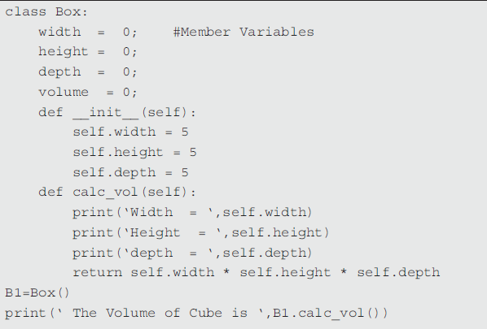
The Constructor ( __init__( ) ) :
Accessibility
xxx
Output :
Width = 5
Height = 5
Depth = 5
The Volume of Cube is 125
Notes:
The member variable of class Box is initialised to zero. Thereafter, all the member
variables, viz. width, height and depth are reinitialised to the value 5 by instantiating the object B1
and using the init method.

Slide 59
Object Orientation : Classes
Examples

Slide 60
Introduction to Object Orientation :
(Example: Employee)
The variable empCount is a class variable whose value is shared among all instances of a this class. This can be accessed as Employee.empCount from inside the class or outside the class.
The first method __init__() is a special method, which is called class constructor or initialization method that Python calls when you create a new instance of this class.
You declare other class methods like normal functions with the exception that the first argument to each method is self. Python adds the self argument to the list for you; you do not need to include it when you call the methods.

Slide 61
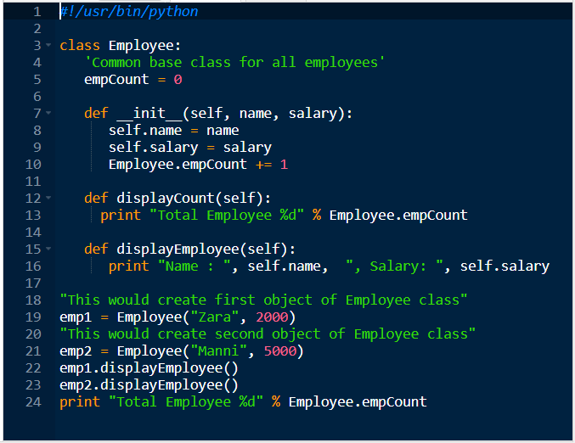
Python Programming - Introduction to Object Orientation :
xxxx
xxxx

Slide 62
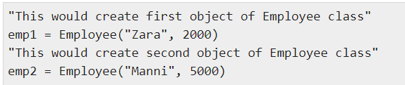
Introduction to Object Orientation :
(Example: Employee) - Creating Instance Objects
To create instances of a class, you call the class using class name and pass in whatever arguments its __init__ method accepts.

Slide 63

Introduction to Object Orientation :
(Example: Employee) - Accessing Attributes
You access the object's attributes using the dot operator with object. Class variable would be accessed using class name as follows −

Slide 64
Introduction to Object Orientation :
(Example: Employee) -
Output :
Name : Zara ,Salary: 2000
Name : Manni ,Salary: 5000
Total Employee 2
You can add, remove, or modify attributes of classes and objects at any time −
emp1.age = 7 # Add an 'age' attribute.
emp1.age = 8 # Modify 'age'
attribute. del emp1.age # Delete 'age' attribute.

Slide 65
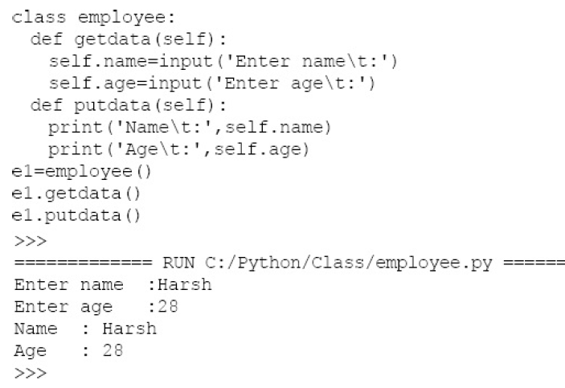
Introduction to Object Orientation :
(Example: Employee) - Creating Classes – Example 03
xx
instantiation
Calling a method

Slide 66
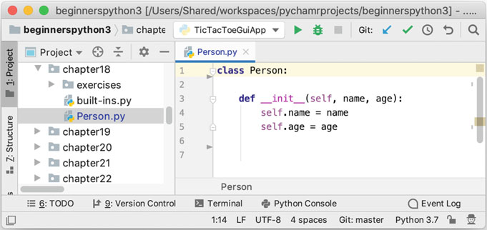
Introduction to Object Orientation :
(Example: Person) Creating Classes
xx

Slide 67
Introduction to Object Orientation :
(Example: Person) - Creating Classes
The Person class possesses two attributes (or instance variables) called name and age.
There is also a special method defined called __init__. This is an initialiser (also known as a constructor) for the class. It indicates what data must be supplied when an instance of the Person class is created and how that data is stored internally.
In this case a name and an age must be supplied when an instance of the Person class is created.
The values supplied will then be stored within an instance of the class (represented by the special variable self) in instance variables/attributes self.name and self.age.

Slide 68
Introduction to Object Orientation :
(Example: Person) - Creating Classes
Note that the parameters to the __init__ method are local variables and will disappear when the method terminates, but self.name and self.age are instance variables and will exist for as long as the object is available.
Let us look for a moment at the special variable self. This is the first parameter passed into any method. However, when a method is called we do not pass a value for this parameter ourselves; Python does. It is used to represent the object within which the method is executing. This provides the context within which the method runs and allows the method to access the data held by the object. Thus self is the object itself.
A method is the name given to behaviour that is linked directly to the Person class; it is not a free-standing function rather it is part of the definition of the class Person.

Slide 69
Introduction to Object Orientation :
(Example: Person) - Creating Instances of the Class Person
New instances/objects (examples) of the class Person can be created by using the name of the class and passing in the values to be used for the parameters of the initialisation method (with the exception of the first parameter self which is provided automatically by Python).

Slide 70
Introduction to Object Orientation :
(Example: Person) - Creating Instances of the Class Person
For example, the following creates two instances of the class Person:
p1 = Person('John', 36)
p2 = Person('Phoebe', 21)
The variable p1 holds a reference to the instance or object of the class Person whose attributes hold the values 'John' (for the name attribute) and 36 (for the age attribute). In turn the variable p2 references an instance of the class Person whose name and age attributes hold the values 'Phoebe' and 21. Thus in memory we have:

Slide 71
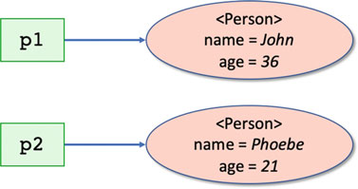
Introduction to Object Orientation :
(Example: Person) - Creating Instances of the Class Person
Thus in memory we have:
The two variables reference separate instances or examples of the class Person. They therefore respond to the same set of methods/operations and have the same set of attributes (such as name and age); however, they have their own values for those attributes (such as 'John' and 'Phoebe').
Each instance also has its own unique identifier—that shows that even if the attribute values happen to be the same between two objects (for example there happen to be two people called John who are both 36); they are still separate instances of the given class.
This identifier can be accessed using the id() function, for example:

Slide 72
Introduction to Object Orientation :
(Example: Person) - Creating Instances of the Class Person
Each instance also has its own unique identifier—that shows that even if the attribute values happen to be the same between two objects (for example there happen to be two people called John who are both 36); they are still separate instances of the given class.
This identifier can be accessed using the id() function, for example:
print('id(p1):', id(p1))
print('id(p2):', id(p2))
When this code is run p1 and p2 will generate different identifiers, for example:
id(p1): 4547191808
id(p2): 4547191864

Slide 73
Introduction to Object Orientation :
(Example: Animal) - Creating an Instance of a Class
Now that you have defined a class, you can easily create instances of the class:
>>> animal = Animal (" thing ")
In the above Animal is the class to create, and animal is a variable holding the instance of the class. The animal variable now references an instance of Animal.
This instance has “state”, which consists of a name, "thing". When the instance of the class is instantiated or created, the constructor (__init__) is called. Within the body of the constructor you can define the state of an instance by binding data to self.

Slide 74
Introduction to Object Orientation :
(Example: Animal) - Calling a Method in a Class
Now that you have an instance of a class, you can call methods on it.
Methods are invoked by adding parentheses with any arguments inside of them. The talk method does not require arguments, Python takes care of passing self automatically:
>>> animal . talk ()
Generic Animal Sound

Slide 75
Introduction to Object Orientation
Display Class Attributes and Methods

Slide 76
Display Class Attributes & Methods :
Examining an Instance
If you have an instance and would like to know what its attributes are, you have a few options. You can look up the documentation (if it exists). You can read the code where the class was defined. Or you can use dir to examine it for you:
There are two ways to determine the attributes in a class. One way is by using the inbuilt function dir(). The syntax used to display dir() attributes is:
    dir(name_of_class) or
    dir(Instance_of_class)

Slide 77
Display Class Attributes & Methods :
Accessing Object Attributes
We can access the attributes held by p1 and p2 using what is known as the dot notation. This notation allows us to follow the variable holding the object with a dot ('.') and the attribute we are interested in access. For example, to access the name of a person object we can use p1.name or for their age we can use p1.age:
print(p1.name, 'is', p1.age)
print(p2.name, 'is', p2.age)
------------------------------------------------
p1.name = 'Bob'
p1.age = 54
print(p1.name, 'is', p1.age)
Output :
id(p1): 4326491864
id(px): 4326491864
Output :
Bob is 54
Notes:
- We can restrict access to these attributes by making them into properties.

Slide 78
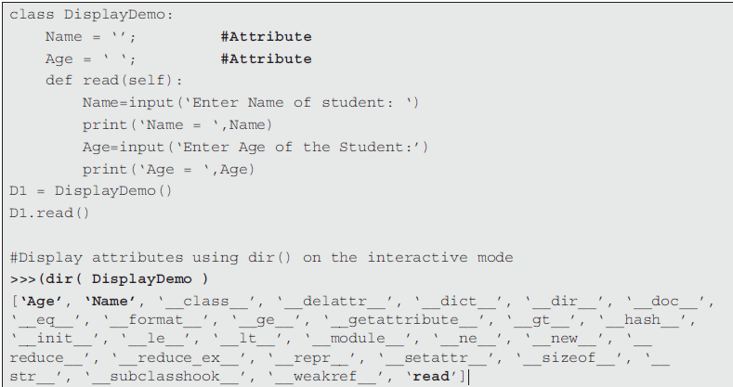
Display Class Attributes & Methods ::
Examining an Attribute of a Class
xx
The dict contains two underscores i.e. two underscores before the word dict and two
underscores afterwards.
Notes:
When dir() method is executed in interactive mode, the dir() function returns a sorted list of attributes and methods belonging to an object. The function returns the existing attributes and methods belonging to the class, including any special methods.

Slide 79
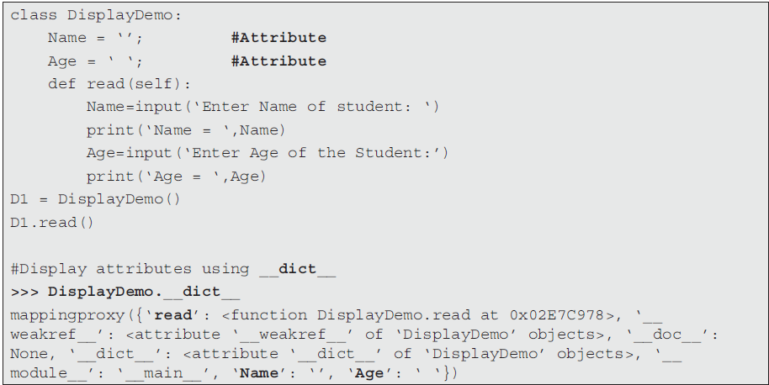
Display Class Attributes & Methods ::
Examining an Attribute of a Class
xx
Notes:
The special class attribute __dict__ returns the details of the class containing methods and attributes. The output of the above function returns the address of the method read, i.e. {‘read’: <function DisplayDemo.read at 0x02E7C978>. It also displays the attributes of the class DisplayDemo, viz. Name and Age.

Slide 80
Display Class Attributes & Methods ::
Examining an Instance
>>> dir( animal )
[’ __class__ ’, ’__delattr__ ’,
’__dict__ ’, ’__doc__ ’, ’__format__ ’,
’__getattribute__ ’, ’__hash__ ’,
’__init__ ’, ’__module__ ’, ’__new__ ’,
’__reduce__ ’, ’__reduce_ex__ ’,
’__repr__ ’, ’__setattr__ ’,
’__sizeof__ ’, ’__str__ ’,
’__subclasshook__ ’, ’__weakref__ ’,
’name ’, ’talk ’]
Notes:
Note that an instance of animal has the attributes for both the data bound to the instance (in the __init__ method), as well as any methods defined. You see the name attribute for the data and the talk attribute for the method.

Slide 81
Display Class Attributes & Methods :
Built-In Class Attributes
Every class (and every object) in Python has a set of intrinsic attributes set up by the Python runtime system. Some of these intrinsic attributes are given below for classes and objects.
Classes have the following intrinsic attributes:
• __name__ the name of the class
• __module__ the module (or library) from which it was loaded
• __bases__ a collection of its base classes (see inheritance later in this book)
• __dict__ a dictionary (a set of key-value pairs) containing all the attributes (including methods)
• __doc__ the documentation string.

Slide 82
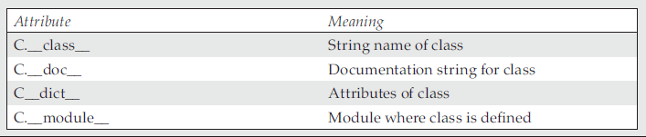
Display Class Attributes & Methods :
Built-In Class Attributes
For objects:
• __class__ the name of the class of the object
• __dict__ a dictionary containing all the object’s attributes.
Notice that these intrinsic attributes all start and end with a double underbar— this indicates their special status within Python.

Slide 83
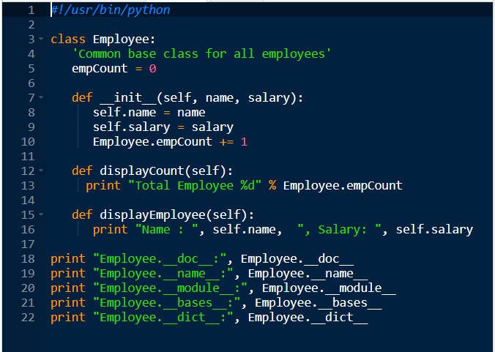
Python Programming - Introduction to Object Orientation :
Built-In Class Attributes
xxxx

Slide 84
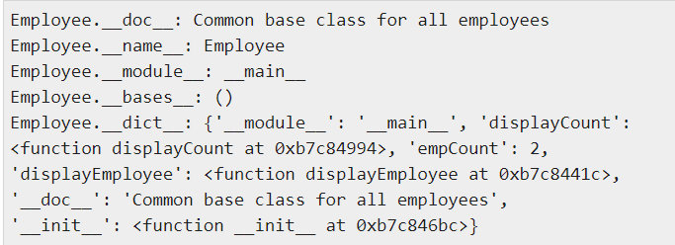
Display Class Attributes & Methods :
Built-In Class Attributes
Output :

Slide 85
Display Class Attributes & Methods :
Intrinsic Attributes
print('Class attributes')
print(Person.__name__)
print(Person.__module__)
print(Person.__doc__)
print(Person.__dict__)
print('Object attributes')
print(p1.__class__)
print(p1.__dict__)
<< Exercise B18 >>

Slide 86
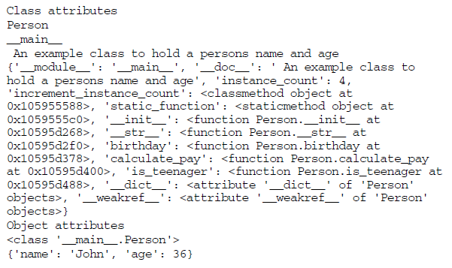
Display Class Attributes & Methods :
Intrinsic Attributes (Output)
print('Class attributes')
print(Person.__name__)
print(Person.__module__)
print(Person.__doc__)
print(Person.__dict__)
print('Object attributes')
print(p1.__class__)
print(p1.__dict__)

Slide 87
Object Orientation
Accessibility

Slide 88
Introduction to Object Orientation :
Accessibility
In Python, there are no keywords like public, protected or private. All attributes and methods are public by default.
There is one way to define private in Python. The syntax to define private attribute and methods is
__Attribute
__Methods_Name()
To make an attribute and a method private, we need to add two underscores, i.e. “__” in front of the attribute and the method’s name. It helps in hiding these when accessed out of class.

Slide 89
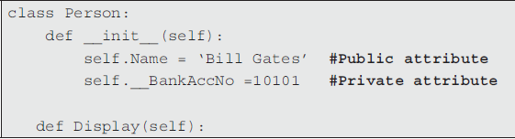
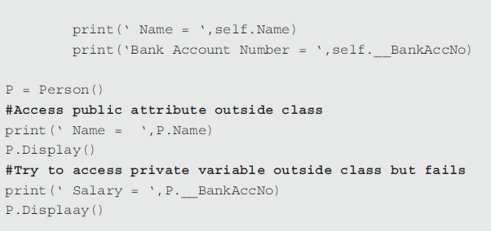
Introduction to Object Orientation :
Accessibility
xx

Slide 90
Introduction to Object Orientation :
Accessibility
Output :
Name = Bill Gates
Name = Bill Gates
Bank Account Number = 10101
Traceback (most recent call last): #Error
File “C:/Python34/PrivateDemo.py”, line 13, in <module>
print(‘ Salary = ‘,P.__BankAccNo)
AttributeError: ‘Person’ object has no attribute ‘__BankAccNo’
xx
Notes:
In the above program, we have defined public and private attributes. The private variable can be accessed within the function. We have created an instance of class Person, i.e. P to access the attributes defined within the class.
However, it fails and shows an error when instance of class try to access private attributes defined inside the class & are accessed from outside the class.

Slide 91
Object Orientation
Passing an Object as parameter to a method

Slide 92
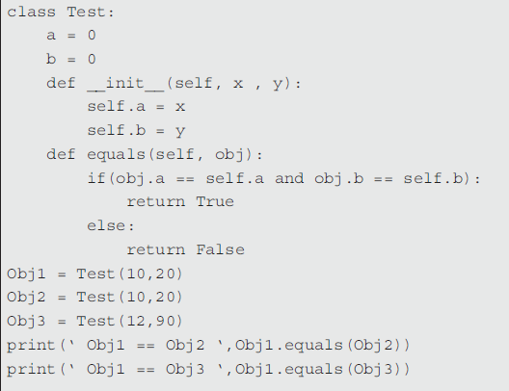
Passing an Object as parameter to a Method :
Passing object as parameter
xxx
Output :
Obj1 == Obj2 True
Obj1 == Obj3 False
Notes:
In the above program, the equals() method inside the class named Test compares two objects for equality and returns a result. It compares the invoking object with one that is passed as parameter to the method.
ob1.equals(ob2)
As shown above, the invoking object is ob1 and the object being passed to the equals method is ob2. If the values of ob1 and ob2 contain the same value then the method returns True, else it returns False.

Slide 93
Passing an Object as parameter to a Method :
Passing object as parameter - Example
class Rectangle:
length = 0
breadth = 0
def __init__(self, l , w):
self.length = l
self.breadth = w
def Calc_Area(self, obj):
print(‘ Length = ‘,obj.length)
print(‘ Breadth = ‘,obj.breadth)
return obj.length * obj.breadth
Obj1 = Rectangle(10,20)
print(‘The area of Rectangle is ‘, Obj1.Calc_Area(Obj1))
Output :
Length = 10
Breadth = 20
The area of Rectangle is 200
Notes:
The object Obj1 of class Rectangle is instantiated. With the help of init method, the
default values of length and rectangle are initialised to 100 and 200. The Obj1 itself is passed as
parameter to the method Calc_area() and finally the area of the rectangle is computed.

Slide 94
The Destructor ( __del__( ) ) :
__del__() (destructor method)
The method __del__ denotes the destructor and the syntax to define destructor is.
def __del__(self)
block
Python invokes the destructor method when the instance is about to be destroyed. It is invoked one per instance. The self refers to the instance on which the __del__() method is invoked. In other words, Python manages garbage collection of objects by reference counting. This function is executed only if all the references to an instance object have been removed.

Slide 95
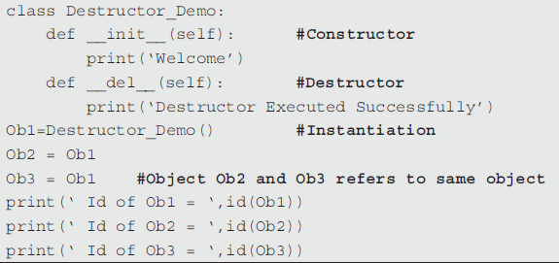

Introduction to Object Orientation :
__del__() (destructor method)
xx
Output :
Welcome
Id of Ob1 = 47364272
Id of Ob2 = 47364272
Id of Ob3 = 47364272
Destructor Executed Successfully
Notes:
In the above example, we have used constructor __init__ and destructor __del__
functions. Initially we have instantiated the object Ob1 and then assigned aliases Ob2 and Ob3 to it. The inbuilt function id() is used to confirm that all the three aliases reference to the same object.
Finally, all the aliases are removed using the del statement.
The destructor __del__ is not invoked unless all the aliases are deleted.
The destructor is called exactly once.

Slide 96

Thank you

